Slide 1
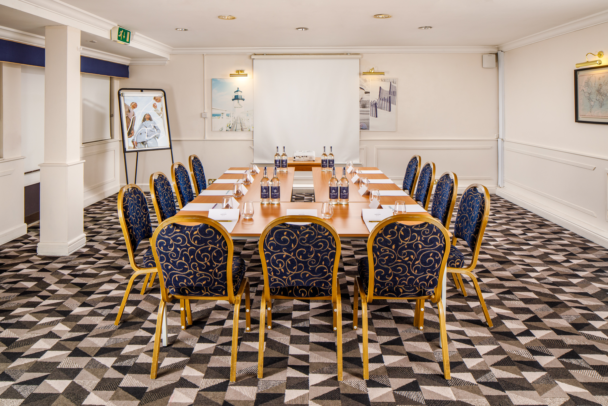
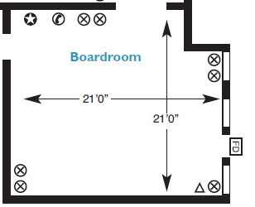
BOARDROOM
With ground floor access the Boardroom is one of our most popular rooms and is fully accessible.
Key Information
Floor | Ground
Disabled access | Yes
Natural Daylight | Yes
Air Conditioning | No
Setup | Capacity
Theatre | 16
Cabaret | 8
Boardroom | 14
Classroom | 12
U-shape | 12
Dinner | 14
Room Dimensions
Length & Width | 6.40m x 6.40m
Square Metres | 40.96

